Slide 1


JAGDEEP SINGH MAAN
December 2, 2022

Slide 2

Outline
Executive Summary
Introduction
Methodology
Results
Conclusion
Appendix

Slide 3
Executive Summary
Summary of methodologies
Data Collection
Data Wrangling
Exploratory Data Analysis With Data Visualization
Exploratory Data Analysis With SQL
Building An Interactive Map With Folium
Building A Dashboard With Plotly Dash
Predictive Analysis (Classification)
Summary of all results
Exploratory Data Analysis Results
Interactive Analytics
Predictive Analysis

Slide 4
Introduction
Project background and context
Space Exploration Tehcnologies Corporation is an American Spacecraft Manufacturer, Launcher and a Satellite Communications Corporation Headquartered in Hawthrone, California Founded by Elon Musk in 2002 with aim of reducing space transportation costs.
Problems you want to find answers
This Project is looking to find answer about 'Will SpaceX Falcon Launcher will Successfully Land back to earth after spacecraft or satellite Launch?'

Slide 5

Section 1

Slide 6
Methodology
Executive Summary
Data collection methodology:
Data Collection using SpaceX API
Data Collection with Web Scrapping From Wikipedia
Perform data wrangling
Changing categorical data into numeric data.
Perform exploratory data analysis (EDA) using visualization and SQL
Perform interactive visual analytics using Folium and Plotly Dash
Perform predictive analysis using classification models
Build Better Classification Models using Model Training and Cross Validation.

Slide 7
Data Collection
Methods use for Data Collection:
SpaceX REST API
Data is collected using SpaceX REST API which contains detailed information about past SpaceX launches..
Web Scraping Method:
SpaceX's Wikipedia page includes a lot of information about SpaceX launches and data is collected using BeautifulSoup Python Library

Slide 8
Data Collection – SpaceX API
SpaceX REST API link
https://api.spacexdata.com/v4/launches/past"
GitHub Link For Notebook
https://github.com/JagdeepMaan/JagdeepMaan/blob/fd89c17c97e38471e2fd6bc7bca8ab76ab95ab5b/spacex-data-collection-api.ipynb
Request and Parse launch data using SpaceX REST API
Normalize . JSON results and convert into DataFrame
Remove unnecessary data using Filters and Functions
Data is ready for Data Cleaning and Wrangling

Slide 9
Data Collection - Scraping
SpaceX Wikipedia Page
https://en.wikipedia.org/w/index.php?title=List_of_Falcon_9_and_Falcon_Heavy_launches&oldid=1027686922
GitHub Link For Notebook
https://github.com/JagdeepMaan/JagdeepMaan/blob/beac177fcad3b505cfe9514881aa8670ee15b279/jupyter-labs-webscraping.ipynb
Create BeautifulSoup Object from HTML response
Extract all columns/variables from HTML table header
Parse launch HTML table to Create Dataframe
Data is ready for Data Cleaning and Wrangling

Slide 10
Data Wrangling
SpaceX Launch Outcomes were converted into numerical data and added 'class' column to describe if launch outcome was successful.
0 = Unsuccessful, 1 = Successful
GitHub Link For Notebook
https://github.com/JagdeepMaan/JagdeepMaan/blob/dc49aeffbfed2aa33ab38655783e71df9fdc1759/IBM-DS0321EN-SkillsNetwork_labs_module_1_L3_labs-jupyter-spacex-data_wrangling_jupyterlite.jupyterlite.ipynb
Find types mission outcomes from SpaceX Dataframe
Create a list of bad/unsuccessful_Outcomes
Add a 'Class' column to dataframe and assign
value 0 if mission outcome is in bad_outcomes , else 1
Data is ready for Exploratory Data Analysis

Slide 11
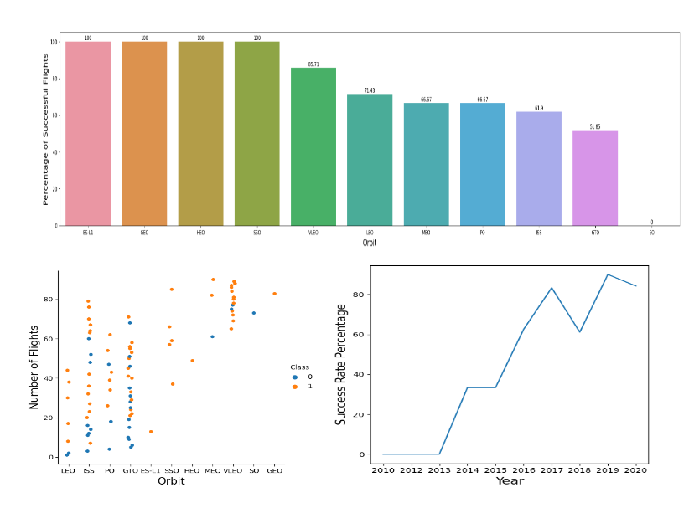
EDA with Data Visualization
In Exploratory Data Analysis collected and cleaned data is used to show relationships between variables to know more about the data points by visualization of data in charts and graphs.
GitHub Link For Notebook
https://github.com/JagdeepMaan/JagdeepMaan/blob/d1b6aa6a2317fa7895b478612bdebfa0031f15b8/eda-dataviz.ipynb.jupyterlite.ipynb

Slide 12
EDA with SQL
In Exploratory Data Analysis collected and cleaned data using Structured Query Language -SQL.
GitHub Link For Notebook
https://github.com/JagdeepMaan/JagdeepMaan/blob/bad2eae720995b4c1d59da8f0369b785cf403206/jupyter-labs-eda-sql-coursera_sqllite.ipynb
SQL Queries Used For Data Analysis
Getting Launch Sites Names
Total Payload Carried By All Spacecrafts
Average Payload Per Flight
Number of Successful Mission Outcomes
First successful launch with safe booster landing on ground pad
Name of Booster Versions

Slide 13
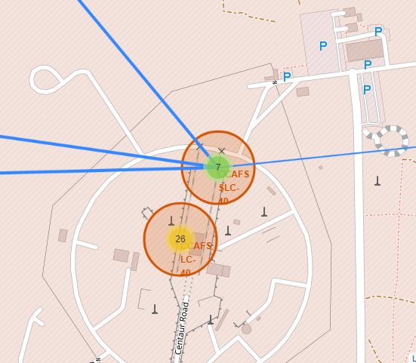
Build an Interactive Map with Folium
Interactive Map with Folium
Adding Marker and Circle for each SpaceX Launch Site.
Marked all Flights from each launch site using Marker Cluster object.
Added Lines From CCAFS SLC-40 to Landmarks
GitHub Link For Notebook
https://github.com/JagdeepMaan/JagdeepMaan/blob/3ddb5aa85021aff0d5eedb221c1ec3ed79523e1f/launch_site_location.jupyterlite.ipynb

Slide 14
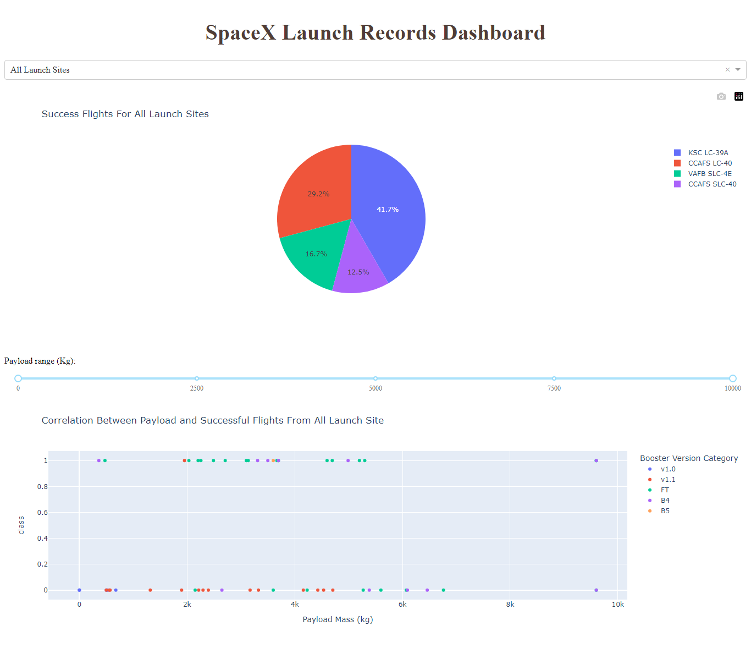
Build a Dashboard with Plotly Dash
Added Pie Chart
Displaying percentage number of flights from each launch site
Added Scatter Chart with Range Slider
Filter using payload mass to get data points about launches with different booster versions.
GitHub Link For Notebook
https://github.com/JagdeepMaan/JagdeepMaan/blob/80bc9896feb35dcfcd7cbefc91ecb9aa298f264c/spacex_dash_app.py

Slide 15
Predictive Analysis (Classification)
Models for Predictive Analysis
Linear Regression
DecisionTree Classifier
Support Vector Classifier
KNearest Neighbors
GitHub Link For Notebook
https://github.com/JagdeepMaan/JagdeepMaan/blob/482eb477fb8b265eed41158686f912b3cdc187bd/IBM-DS0321EN-SkillsNetwork_labs_module_4_SpaceX_Machine_Learning_Prediction_Part_5.jupyterlite.ipynb
Use StandardScaler Object to standardize data
Divide data in training and testing sets using train_test_split
Choose Classification Model and Train model
Use GridSearchCV to get best parameters, accuracy score for model evaluation

Slide 16
Results
Exploratory Data Analysis
Flight Number vs Launch Site, Payload vs Launch Site, Success Rate vs Orbit,
Payload vs Orbit, Yearly Launch Success Rate, All Launch Sites Name, Total
Payload Mass, Launch By Year
Interactive Data Visualization with Folium Map
SpaceX Launch Site on Folium Map With Landing Outcome, Distance from Launch Site
To Important Locations
Predictive analysis results
Classification Model with Accuracy Score, Confusion Matrix

Slide 17

Section 2

Slide 18
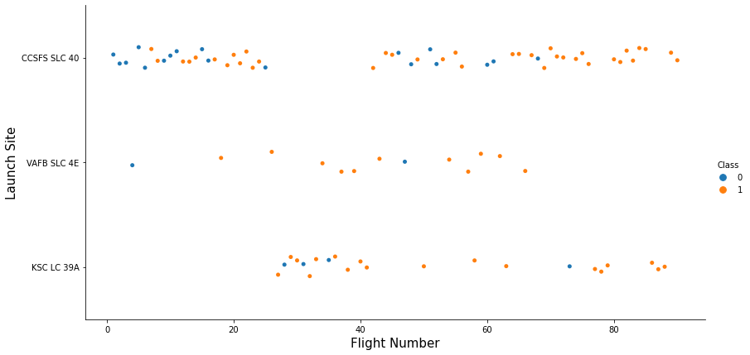
Flight Number vs. Launch Site
Recent Landing Outcomes for Flights were successful as boosters safely landed back to earth.
SpaceX used CCSFS SLC-40 and KSC LC-39A for Recent Launches.

Slide 19
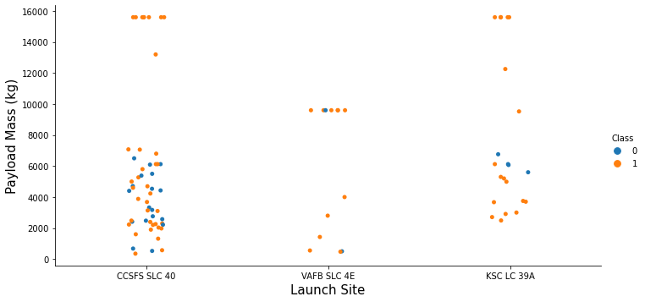
Payload vs. Launch Site
CCSFS SLC-40 and KSC LC-39A launch sites were used for launch of spacecraft
carried more than 10000 kg payload mass.

Slide 20
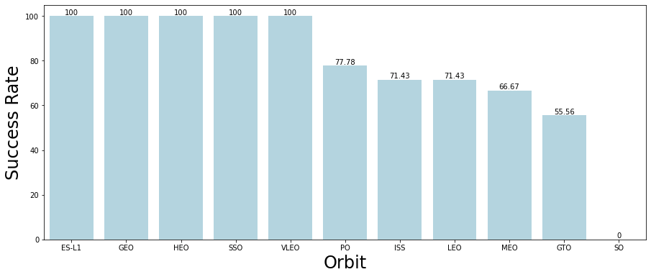
Success Rate vs. Orbit Type
SpaceX has 100 percentage Success Rate for placing Satellites in
ES-L1, GEO, HEO, SSO and VLEO Orbits

Slide 21
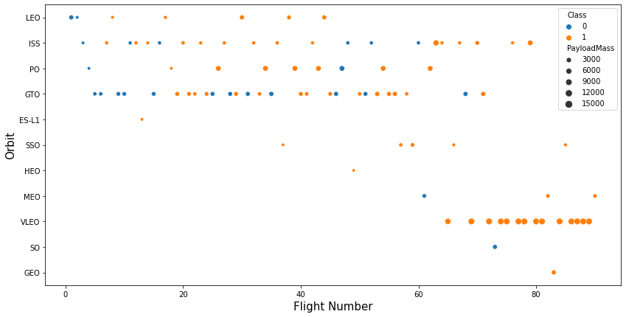
Flight Number vs. Orbit Type
VLEO Orbit is very popular as SpaceX has placed many heaviest satellites in recent flights

Slide 22
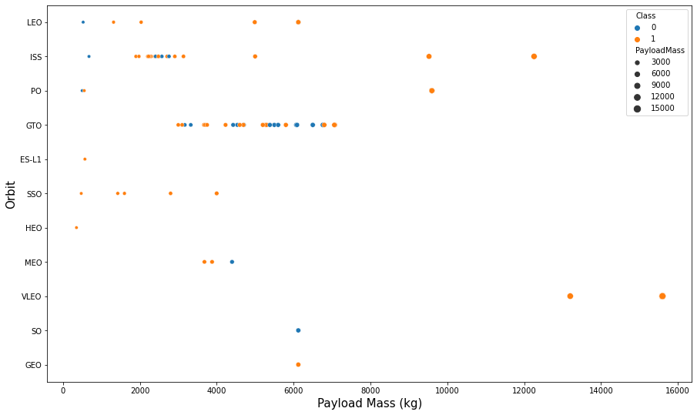
Payload vs. Orbit Type
Heaviest Satellite is placed in VLEO Orbit

Slide 23
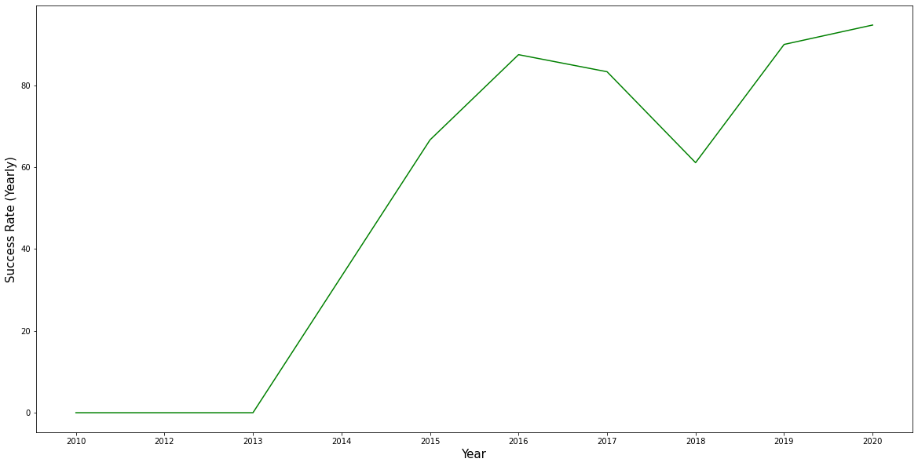
Launch Success Yearly Trend
Succes Rate increased sharply after year 2013

Slide 24
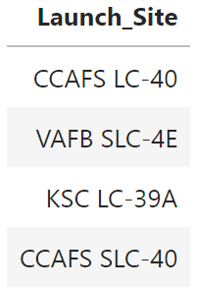
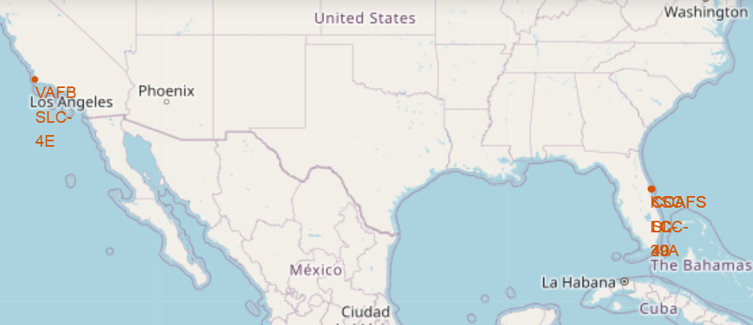
All Launch Site Names
%sql SELECT DISTINCT(Launch_Site) FROM SPACEXTBL

Slide 25
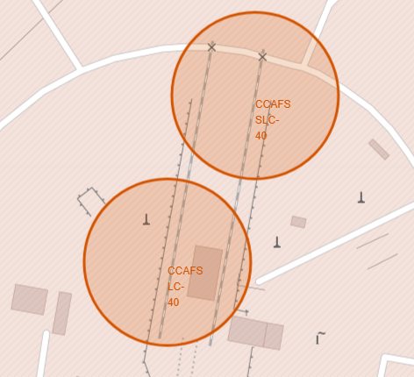
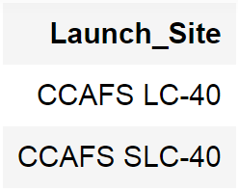
Launch Site Names Begin with 'CCA'
%sql SELECT * FROM SPACEXTBL WHERE Launch_Site LIKE 'CCA%'
GROUP BY Launch_Site LIMIT 5

Slide 26
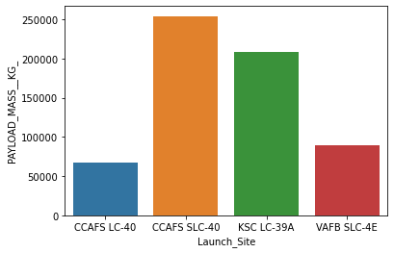
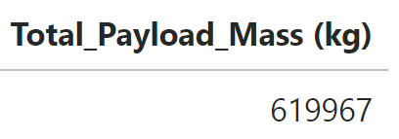
Total Payload Mass
%sql SELECT SUM(PAYLOAD_MASS__KG_) As Total_Payload_Mass (kg)
FROM SPACEXTBL

Slide 27
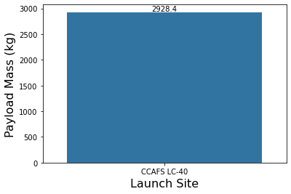
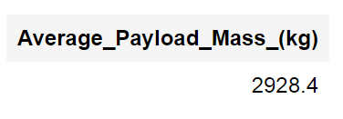
Average Payload Mass by F9 v1.1
%sql SELECT AVG(PAYLOAD_MASS__KG_) AS Average_Payload FROM SPACEXTBL
WHERE Booster_Version == 'F9 v1.1'

Slide 28
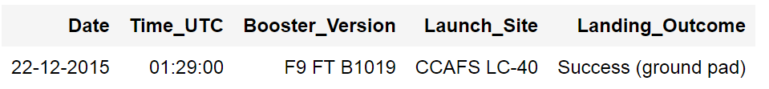
First Successful Ground Landing Date
%sql SELECT Date, Time_UTC, Booster_Version, Launch_Site, Landing_Outcome
FROM SPACEXTBL WHERE Landing_Outcome == 'Success (ground pad)'
ORDER BY Date DESC LIMIT 1;

Slide 29
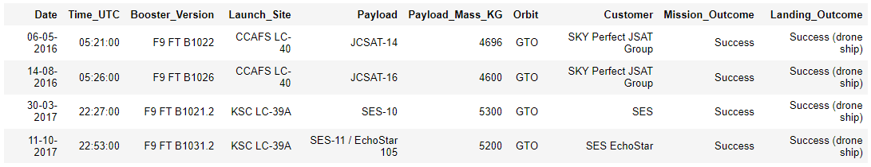
Successful Drone Ship Landing with Payload between 4000 and 6000
%sql SELECT * FROM SPACEXTBL
WHERE Landing_Outcome == "Success (drone ship)" AND
Payload_Mass_KG BETWEEN 4000 AND 9000

Slide 30
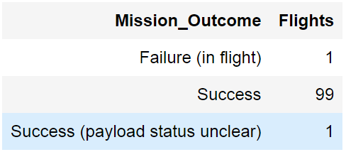
Total Number of Successful and Failure Mission Outcomes
%sql SELECT DISTINCT(Mission_Outcome), COUNT(*) AS Flights
FROM SPACEXTBL GROUP BY Mission_Outcome;

Slide 31
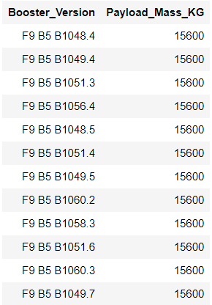
Boosters Carried Maximum Payload
%sql SELECT DISTINCT(Booster_Version), Payload_Mass_KG FROM SPACEXTBL
WHERE Payload_Mass_KG = (SELECT MAX(Payload_Mass_KG) FROM SPACEXTBL)

Slide 32
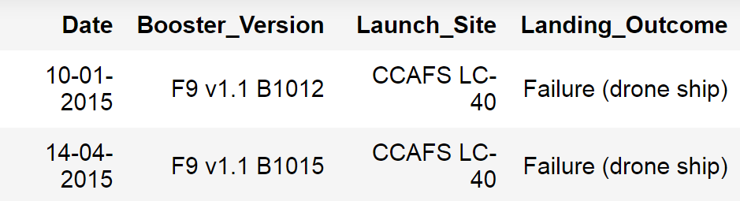
2015 Launch Records ' Failed Landing Outcomes (Drone Ship) '
%sql SELECT Date, Booster_Version, Launch_Site, Landing_Outcome FROM SPACEXTBL
WHERE Landing_Outcome == 'Failure (drone ship)' AND SUBSTRING(Date,7,4) == '2015'

Slide 33
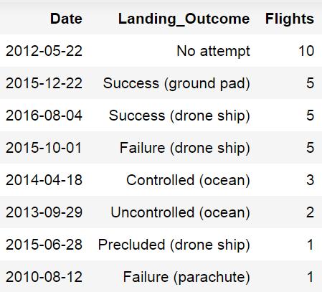
Rank Landing Outcomes Between 2010-06-04 and 2017-03-20
%sql SELECT Date, Landing_Outcome, COUNT(Landing_Outcome) AS Flights FROM SPACEXTBL
WHERE Date BETWEEN '2010-06-04' AND '2017-03-20' GROUP BY Landing_Outcome
ORDER BY Flights DESC;

Slide 34

Section 3

Slide 35
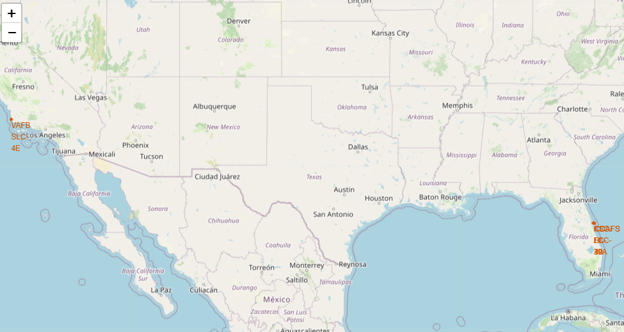
SpaceX Launch Sites Folium Map

Slide 36
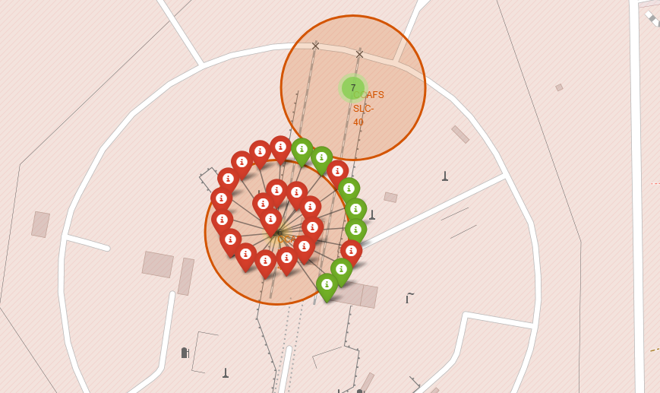
SpaceX Launch Sites Landing Outcomes
Successful Flight Unsuccessful

Slide 37
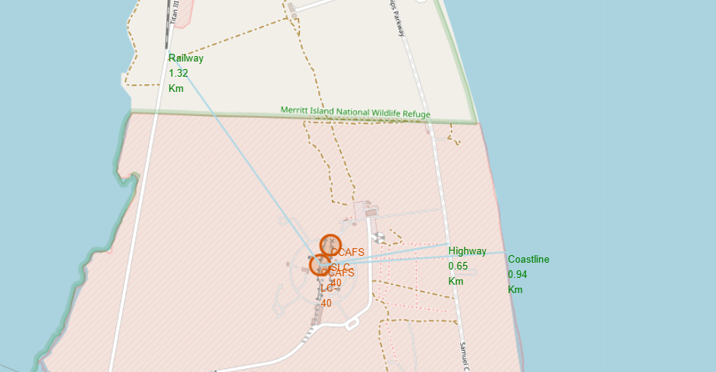
Distances from Launch Site to Important Locations

Slide 38

Section 4

Slide 39
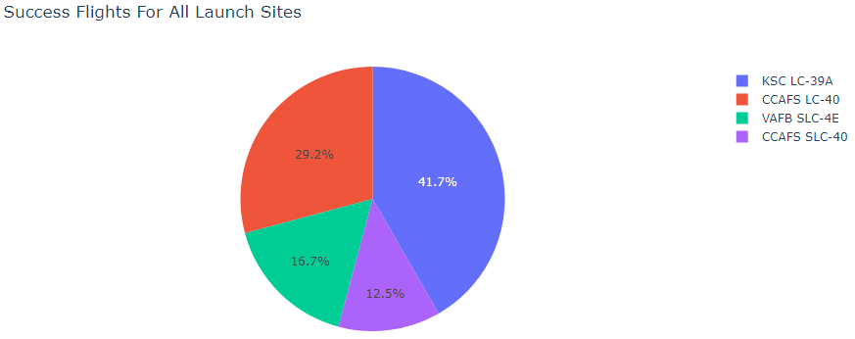
SpaceX Successful Launch Records

Slide 40
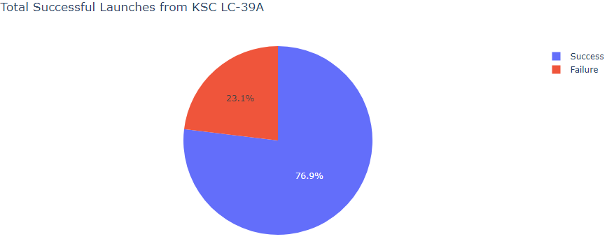
Most Successful Launch Site KSC LC-39A

Slide 41
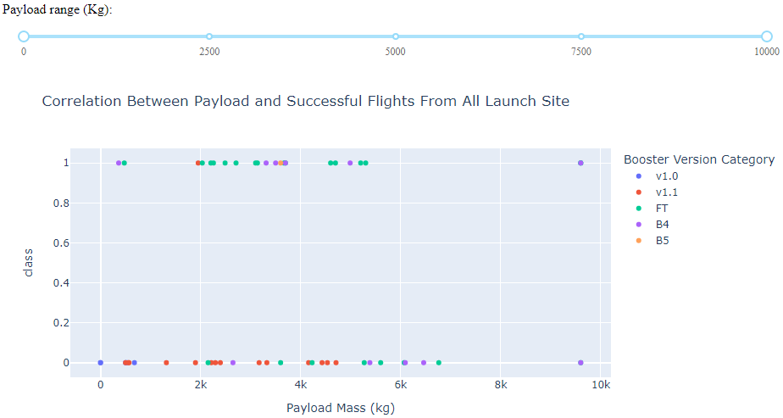
Payload vs. Launch Outcome

Slide 42

Section 5

Slide 43
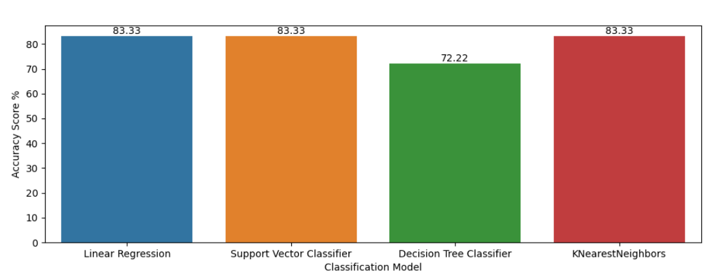
Classification Accuracy

Slide 44
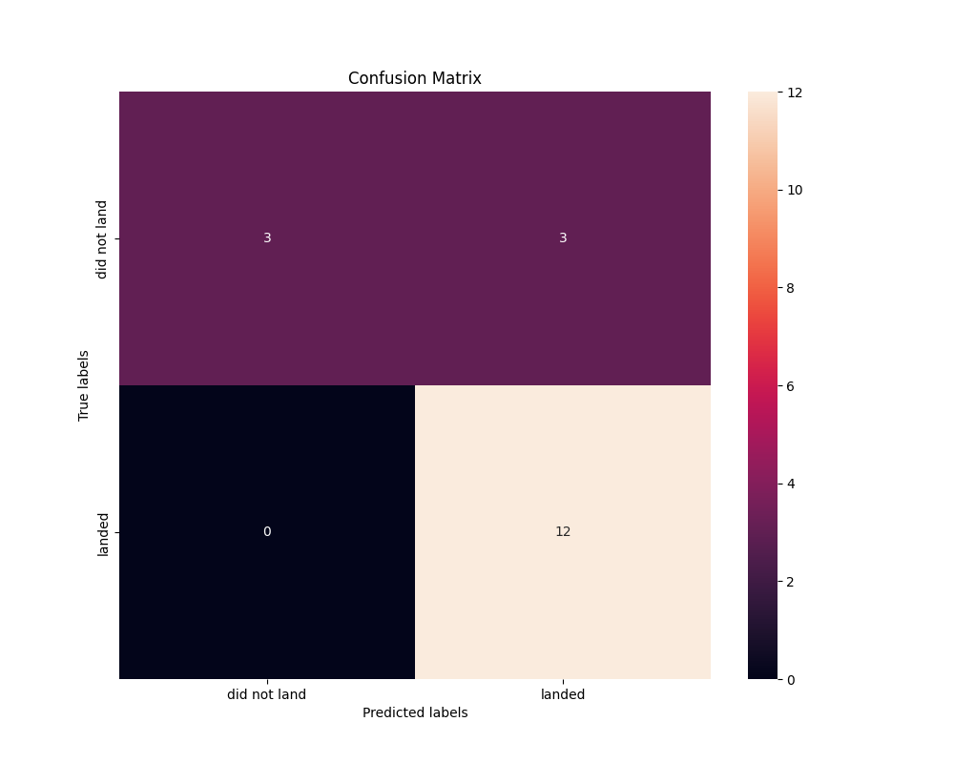
Confusion Matrix ( Best Classification Model)

Slide 45
Conclusions
Launch Site with Most Flights is CCSFS SLC-40 ( 60 Flights )
Most Successful Flights Launch Site is KSC LC-39A ( 76.9% Success Rate )
Launch Success Rate has increased Since 2013.
SpaceX has 100 percentage Success Rate for placing Satellites in
ES-L1, GEO, HEO, SSO and VLEO
Classification Model With Highest Achieved Accuracy Score ( 83.33% )
Linear Regression, Support Vector Classifier and KNearestNeighbors

Slide 46
Appendix
SpaceX Website - https://www.spacex.com/
SpaceX Rest API - https://api.spacexdata.com/v4/launchpads/
SpaceX Wikipedia - https://en.wikipedia.org/wiki/SpaceX
GitHub Repository - https://github.com/JagdeepMaan/JagdeepMaan

Slide 47


